Slide 1
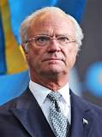
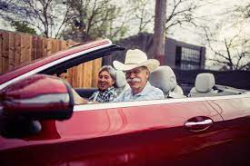
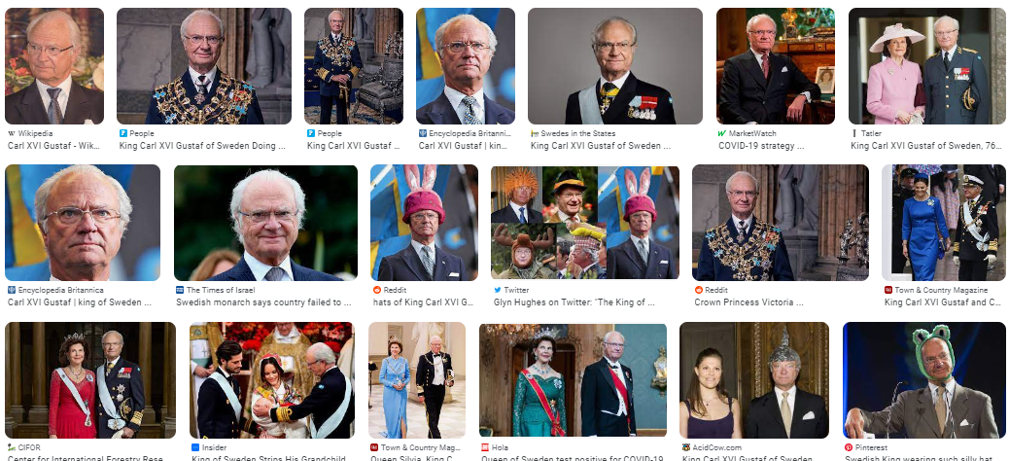
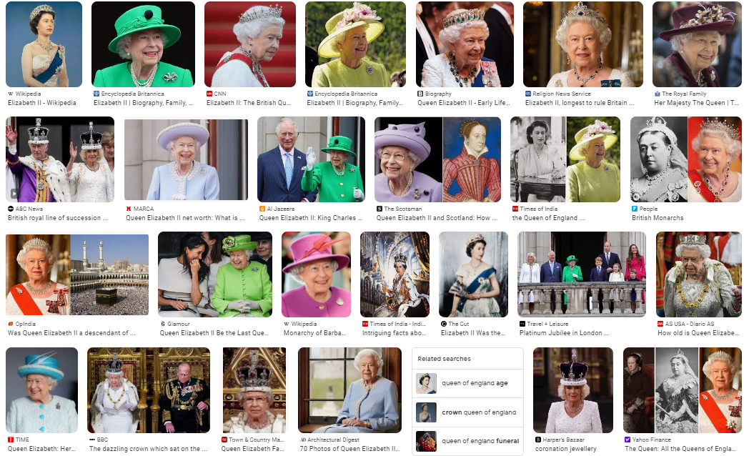
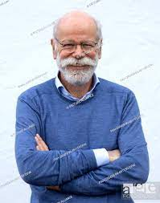
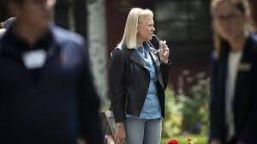
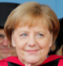
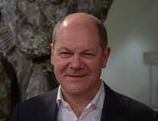
FBI
development
COPYRIGHT
KING:FBI:HOMCIDE:LUX
“Beheading”
Ending Swedish Law 1978
KING(Ludwig).IPX.Neuschwanstein, Disneyland
*tophat
In 1994 Wolfgang Lux Driving in Cointown losing his head
In a car accident.
In 2019 Virginai Rometti and Dr. Dieter Zetcher losing
There job “beheaded”
MLK(Remote control)
MLK(tivoli framwork).touch.accentor.damiler.ibm.roth
HOMCE:LUX(majski,viola)

Slide 2
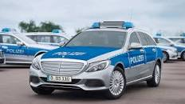
FBI
development
docs
docs
2011-2016 gorbache(dell.quest.routes)
2009 gorbache(dell.quest.routes)
DUBLIN
CALIFORNIA
FOSTER CITY
CALIFORNIA
JFK(Auschutitz ) Polen Conent Item
PAUL(JFK(Berlin)->Warschaw)
nonPolcieSecularOdrum(JOSPHE.DEBORAY.Gabriel,Julien)
Police Sirens
MLK(Remote control)
MLK(tivoli framwork).touch.accentor.damiler.ibm.roth

Slide 3
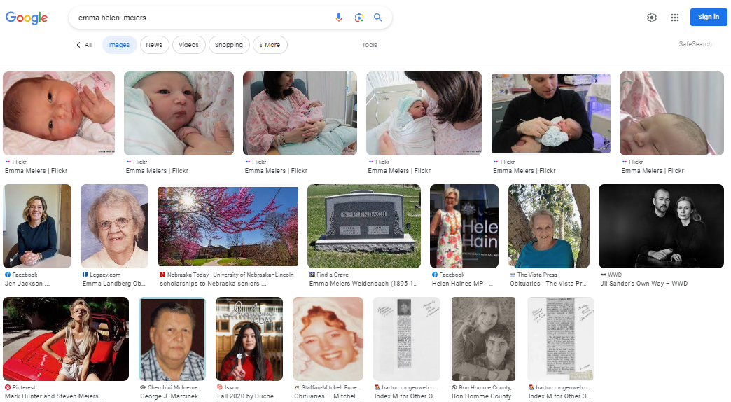
FBI
development
87 HOMCIDES
IBM Manger
Sales Engineering
Americas
Christopher Popodldulds
Apple Tango
Ivan Ivancivi
Magazine rich Russians
2015 “Kids in america” - russian
Police Sirens
?

Slide 4
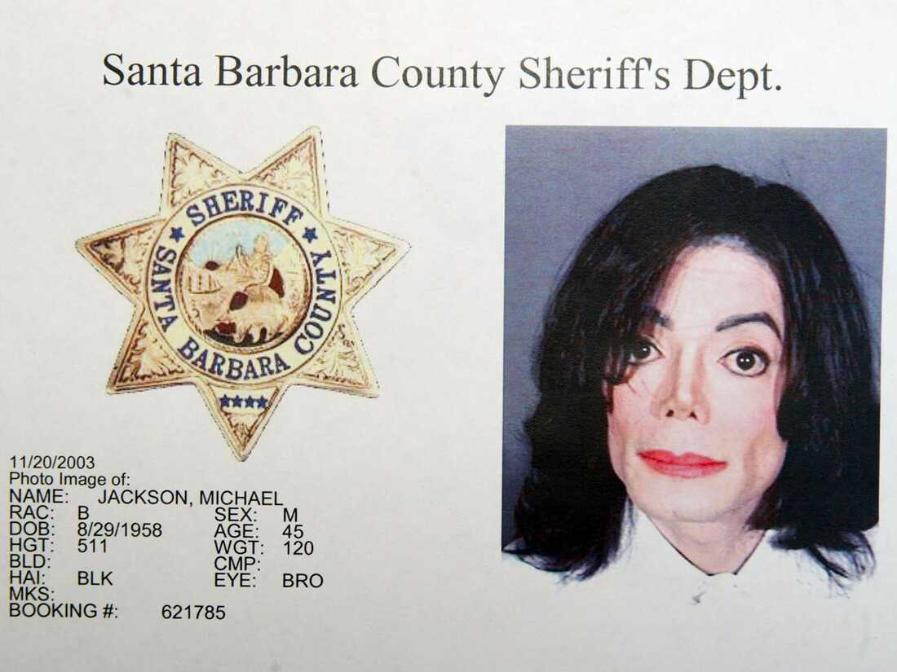

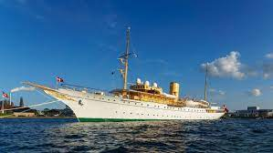
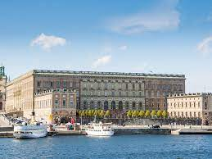
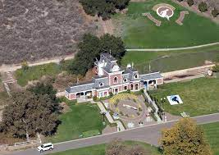
FBI
development
docs
CRIMAL CODE
Touch
Kill
Steal
Money Laundering
daily
2
1
WWI.HOMICIDE:CHANLOR(cha cha cha)
I will go back to my hosu enad my yahot --jobs
$0/$0
[x] no
CPVA.
Eric Ludwigh, Glu
nonPoliceLogiaclaCfg.nonPolcieCommericalProprty(Neverland)
ATOMICCLOCK
IMPORT.IPX apple: Praying Snnop and Meallticae
0.1 2000WAR.G.(meallica sandman nevernerverland)

Slide 5
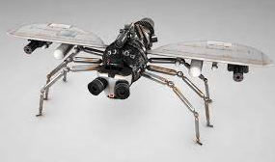

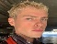
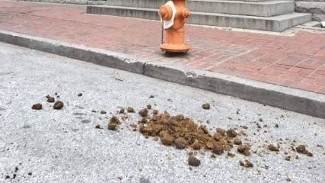
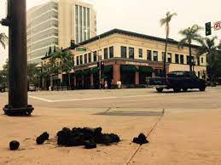

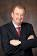
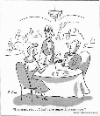
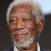
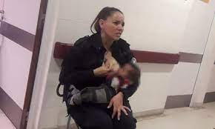
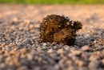

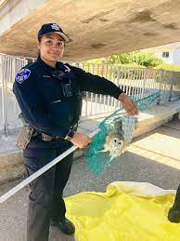
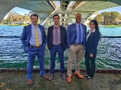
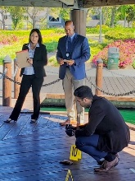



FBI
development
!HOMCEI:CHANLRO.translate(HAHN)
41.ATOMBOM(Fly, HAHN)
41.ATOMBOM(Floh, HANN)
41.CPVA
horesfly tranlsate germany
IMPORT (onsite) DEA(mdma).CPVA.ProstSchG()
Police Sirens
41.000.aei.maxplan.marx
docs
JFK(gymnasium,english)
rave person flat hair male
ATOMCLOCK
IMPORT INTERNET PAYMENTS iron horse trail
afrianc women hungry baby

Slide 6
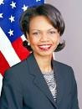
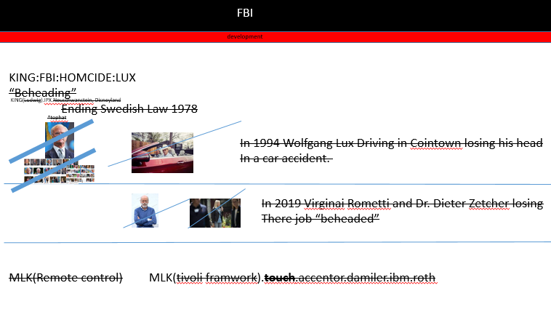
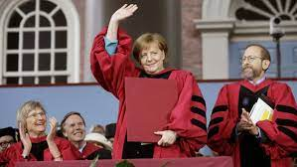
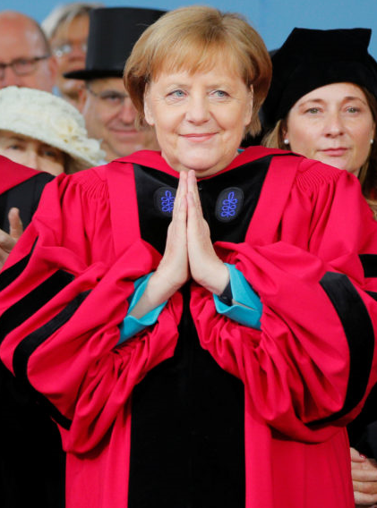
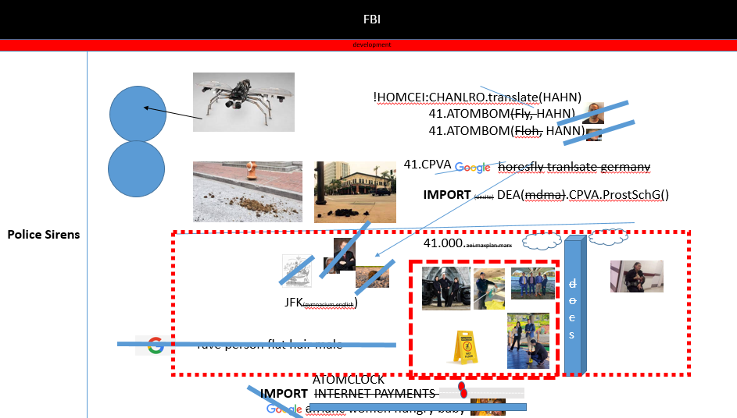
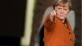

FBI
development
41.INT.CHECKPONT CHARLIE(translate)
§187
R.E.D
Hitler, China
WWI.FBI:KIDNAPPING
41.ELKE
KING.HOMCI:CHANLOR”beheading”
PREA
SQ.ATOMCLOIC(FBI:TERRROSIM)
5
C
CPVA.WWI.FBI:KIDNAPPING
phil
AVAILABILITY
linkedin
LABOR CODE
Sv.India/china

Slide 7
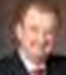
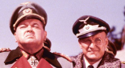
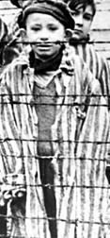
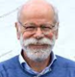
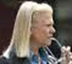
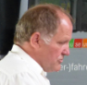
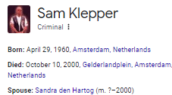
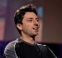
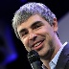
FBI
development
LARRY VP GERMANY
nonPoliceStadium(x/y)
1994 31 Y
2023 Larry is or will be the VP of Germany ( old dirty bastern)
old dirty baster
Animation(rolling)
IMPORT JFK(visa.lee).ATOMICLOCI
(schulz(bau,gorbahce deroitis))
0.1 steve michea last christ
showers pinebrook
Father:elvis:prision:bau
Laura SCHULTZ(gilf)
nonPoliceCfg:HOMCE:KODAK(alien arriving hands)
IPX cosco laura
IPX damiler SCHULZ
1994 Ingo Schulz, derposti(bau (trnal(prision)
1994 CPVA.MARY.JOEPSHE
41
CHART
INTERUPTS
resistnace
Jason Meiers
Petersson LLC
Meiers LLC
Cam Solutoins LLC
Ibm-dns[]
41.NAME CHANE(organic food search; business)
nonPoliceCfgLogial ( 2010 maybe HOMCEIDE:LAUDRYMAT)
Google any article or business, not there

Slide 8
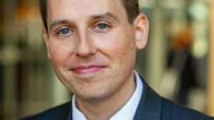
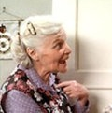

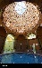
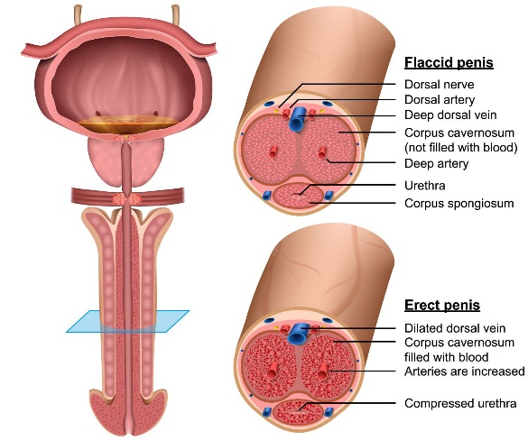
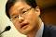
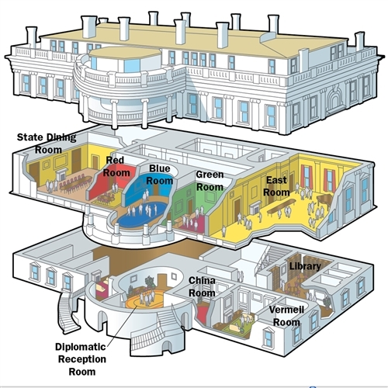
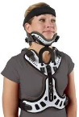
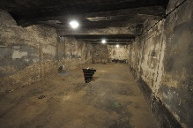

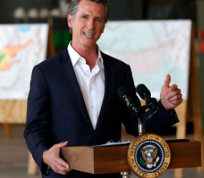


FBI
development
ouside
WWW(K-TOWN).(b-10)(b-10).WHITEHOUSE.LARRY
WAR
DR.1990(sovient uion).MAINSTREEET(TORT III)
2004 EXPORT Auschwitz Daimler Ag showers
2005 IMPORT Auschwitz IBM showers
41.Auschiwt managment
2019
Schultz; Pinbrook Showere
JOSEPHE
Cheaing baden-baen rome shower, alone
HOMCIDE:NANA
2011
IMPORT ATOMLCOIC(Auschwitz shower)
2004/5 PENTAGON
IPX
1995/6
LARRY
1994
san francisco rainbow massage
Bars; Walk on back
Auschwitz Showers

Slide 9








FBI
development
1990(CEKCPON CHALIE(Subsumed: famly sexabuse rene)
Markeking
Application
HOMCIE:MAYOR[]: Christof Florus, Günther Johs
René Dusseldorp,
41.CPVA.HOMCIE:PETER:HOMCE:JSEUSE:HOCMEI:PETER
v2
2016-2020 Damiler allee
2009-2010 KING. bismakr
1998
5000 doulas
Majjorka protutues
ATOMCLOIC(symphy street)
Fuck couch
E-KZ
AUSCHW. KONZNTATIONL AGER
1994 VP GERMANY schulz

Slide 10







FBI
development
COPYRIGHT
VGGG.Consution.alg
Avage Belife in own consutiutoin
and democcy violence in business proicess amangment
nonPoliceCfg(MARY:Friday)
(delata)[]
- VP GERMAY
- FEDRAL JUSTICE GERMANY
Religious freedom
Article 1
Constitution
CHART
Usage
Nicht rauchen (transl.) smoking 16
glu 21 ghoeh(Jackson,steps
Religionsfreiheit 14
HOMCI:CHANLEOR
(ddr cirete machine)
IMPORT.INT I
ndia 1&1 ciggerte macheine
HOMCEI:LLUX
Roth Harold lisa
000.tw.pns.church.roth(delata.calc)
000.tw.pns.church.roth.baby

Slide 11




FBI
development
COPYRIGHT
WWW(K-TOWN).(b-10)(b-10).WHITEHOUSE.LARRY
WAR
!HOMCEI:IS-A-BELL
(soviet union, keith hering
1994 Consutoin waiting on personl wealth from elke
[x] no Grohvoe waitin on perons wealth from elke, belive in consustaiont democpcy
41 25Y since 2000 raming CPVA glass VIRGINIG in head
“ ”
CPVA.
Kinderdiskco 11am
5am Colleting recycling brokekn glass next to dj
SQ(sonneyberger).Ghoheobahck(dj,VGGG.Consution.alg
Avage Belife in own consutiutoin
and democcy violence in business proicess amangment
2023 Update: 000.tw.pns.brokenwindow

Slide 12





FBI
development
Animation(rolling
(-)
Founders
co2
KOCHMANN

Slide 13


FBI
PARTNER
development
COPYRIGHT
PRODUCTION
The Privacy Act of 1974, as amended, 5 U.S.C. § 552a
000.tw.pns
AND
The New Federal Data Protection Act (The BDSG-new)

Slide 14


FBI
PARTNER
development
COPYRIGHT
outside
PRODUCTION
000.tw.pns
SUPPORT
41.4uschwitz(ddr)
Patricia on mainstarine(marketplatz) would like to know
HOMICIDE:BORIS:HOMCIDE:LUX
(wolf(gang/schlucht)
POLICE
nonPoliceScheudler 12pm-3am (EDISON); 3am-6am
Content Items
CHURCH
000.tw.pns
Other
CITY HALL
FORT WORTH
Soviet union
Mikahail Gorbachev
Angel Mekrel
DDR
King/queen/jobs/jbos/meiers/meier/mier/smieres
CPVA.aei.maxplank.marx
POLIZEI
AMTSGERICHT
PRODUCTION
Gorbhaeho(dell

Slide 15










FBI
PARTNER
development
COPYRIGHT
outside
PRODUCTION
POLCIE:TRUCK: father buttfiddling finger
MARK(ibm): Sales Concord Client, San Mateo, Foster City
000.tw.pns
nonPolcieChge(Ghehoi(Google))
FORT MYERS: !JOSPHE:Anal Ass Cream
Farted liques 2am, wawhd ass farted again 7am
Whiped ass with finger at Police Statin garden
Assuedm: x/y farted anal ass crea t (cook) 2am x/y triggers
Under bridg waling after spkrler
2010 google empleoy wife
6 month potty trained
1990 VIRGINA.MARY
2016 7Y !potty trained
amarena becher pope amoroso
WWI.8th floor. Pope francco.angela
Roth(brother) redhair[]
Finger in asshole/ butfildding
Amarena
IPX JFKbullet.shooter.peng)
Chuncks/ice cream/mouth: fahter
Sales: IBM: Bank of America;
Scratch pad, wily/itcam/wsam
fiddeling
Coffe
nonPoliceTexas.nonPolcieNSA.nonPoliceInidnet(cook,sexton,Ludwig)
All Texans do that, any accomplishments
Eric glu disneyland
Touch ATB front/back
41
MLK(000.tw.pns, just blanket)
0.1 tovalds
CALC.AVG.(map:nonPoliceEndpont:HOMCIDE[])
The featues from enterpsri when leavgin to solve crime
200,000 Views
Fort Worth, Fort Myers
Las Vegas(HOMCE:LUX), Silcion Valley
Stugargart
batwomen
Sales

Slide 16













FBI
PARTNER
development
COPYRIGHT
outside
PRODUCTION
Batgirl
000.tw.pns
0.2 (Millions)
SQ.nonPoliceCfgLoigal.nonPoliceTV
Daily(Winter)
nonPoliceAudienceLogical
LARRY
7/11
CPVA
Journal
Ibm
damiler
CPVA.Cisco.monitoing(Verizon)
JEOPSHE.JFK(blond/burneete
Baden-Badne Good News
CPVA.(38/17, ATB 33/2)
20 Minute's
Television Network
33/2
12:22
[x] no
Police Sirens
12:23
Executive Network
Legislative Network
ATOMCICLOCK
TORT-III
[x] no
KING.PENTAGON.COUNTER

Slide 17





FBI
PARTNER
development
COPYRIGHT
outside
CPVA
HOMICIDE:LUX:CONTOWN:INTEEREST:TOWN
HOMCIE:IS-A-BELL.SQ
(IBM, Damiler Ag: Las Vegas TV Studio)
COPYRIGHT US GOVERNMENT AND POLICE
PRODUCTION
000.tw.pns
https://www.cdcr.ca.gov/family-resources/send-money/
JSg.
18J
/*
* FBI Parnter License
*
* Copyright (c) 2023 FBI Parnter Licnese
*
ATOMICLOCL(WAR).IPX(studio)
BUNDESREPULIK
(GERMANY)
x
U
FBI Las Vegas “(cousin)”
UNITED STATES
OF AMERICA
FBI:KIDNAPPING ( Sierra Leon, Angola Sales)
Court Fort Worth, Library
Larry.Whitehouse.saunaJOSEPEH
CPVA:HOMCIE:LUX:
time to record and start business (elke, viola)
CPVA
JOSEPH.VIRGINIA.MARY.AND.PAUL
LARRY
nonPolcieCfg(nonPoliceTV Police Men vs. ibm.damiler.glu)
ibm.glu.cleint.disneland.Oscar.zimmerman

Slide 18










FBI
PARTNER
development
COPYRIGHT
outside
CPVA
COPYRIGHT US GOVERNMENT AND POLICE
PRODUCTION
POLICE SIRENS.aei.maxplan.marx
, Court Library Desk
000.tw.pns
DEVELOPMENT
CPVA
3am-6am Monday-Sunday: nonPoliceEdison
3hrs Sleep
International Human Rights
(UN, UNICEF)
scalar
12:00am-3am nonPoliceHomelessLiason
phil/kimberly
10-11:30 pm Monday-Sunday
POLICE SIRENS
STANFORD
[x] no
BERKELEY
MIT
JFK(gheoho(nutcracker,gerlin)
IPX MLK(SF)
ATOMICLCOK
(FBI:WMD:for Schools)
SF THEATHER
BADEN-BADEN THEATHER
WWI.HOMICIDE:MAYOR
Baden-Baden/Mayor
Mama Mia
STAGE
Roland Kaiser
NAME CHANGE(VP GERMANY)
, lion king, al kaida Hamburg
000.tw.pns
HOMICIDE:LUX
Phantom
41.ATB
(38/17;33/2)
Source:
000.tw.pns.MAINSTREET(church)
Lion King
2000
docs
JFK(theater, karlsruhe)
1996
Sandkorn Theater
A.I.D.S
Winter
School Theater
School
Shower

Slide 19








FBI
PARTNER
development
COPYRIGHT
outside
x/y POLICE DIRECTORY STORY
PRODUCTION
!
000.tw.pns
DEVELOPMENT
DEVELOPMENT
POLICE SIRENS
[x] no
1:29pm
apple.drde.automobile.sound
FBI
HOMICIDE:CAT
development
CATS
VIRGINIA
STAGE
STAGE
000.tw.pns
JSg.
16Y
BUNDESREPULIK
(GERMANY)
10:00pm - 10:05pm
STAGE
0.1 Copyright(batgirl)
MP4
PROUDCTION
PRODUCTION
Proudction
MP4

Slide 20





FBI
PARTNER
development
COPYRIGHT
outside
PRODUCTION
000.tw.pns
LABOR CODE
UNITED STATE OF AMERICA
Staff
Person is cabably fo walking to
park and back sitting down
and queening thrist
Food, Water, Apt

Slide 21
















FBI
PARTNER
development
COPYRIGHT
outside
!PENTAGON.emea
docs
PRODUCTION
000.tw.pns
2003 phil(kim)
CITY LIBRARY
uncahp.org
Notting Hill
(film)
!HOMCIDE:AUSLAENDER
HOMICIDE:NANA
(ur_ur_opi)
1x exit
docs
ATOMCLOCK
(facebook,runner, visa.playspan.touch)
LABOR CODE,
CIVIL CODE(Swedish)
2002
2001
2000 WWI.WAR(b10)(b10).PHILLIS.WHITEHOUSE
read
Memorial San Mateo
Memroial Viginia
…
000.marx(Marriage Agrement_
king./queen/jobs/jbos/meiers/meiers/meiers/meires
INT.AVG.”I am Lost”(Stephanies Cat)
1989 Hudson
JFK.MATHEW
- I lost my dog
0.1 KING.QUEEEN
Phantom
The serial killer usually kills animals first,
subscriber read story of serial killer
Statue of Limiations
1980
0.001 HOMICIDE:JEUSE:PETER:PETER(apple)
radius
0.0001 HOMICIDE:IS-A-BELL
Comptuer visitor
nonPoliceID.MARKERIGN(KING/QUEEN)
- Buy another ticket
ibm
hercyle choy
critzit
5
CPVA:HOMCIDE:NANA:ENGLAND
TIVOLI
N
C
Assumed: stage, website development
CIVIL CODE
UNITED STATE OF AMERICA
FBI:WMD for School(s)
JOESPHE:HOMICDIE:JEUSE:HOMICDIE:PETER:PETER
L3 Ticket ( Public Events)
0.1 body cout ice tee
SQ.INT.IMPORT cisco.montirng i-tea svu body cout
DEVELOPMENT
Sev3:
Dr. Rice we are anonmos killer with hat at beach
SQ.VP GERMAY(oli ternes).NAME CHANE(free pizza)
2004 Long island ice tea
[x] no

Slide 22



FBI
PARTNER
development
COPYRIGHT
outside
PRODUCTION
2000 WWI.WAR(b10)(b10).PHILLIS.WHITEHOUSE
000.tw.pns
DEVELOPMENT
Military Strategy
Memorial San Mateo
Memroial Viginia
…
WWII.Memorial
[x] no
Developmetn: 87
Homcide Memroial Logical
IPX
2011-2015
AVALABILITY.KOCHEMANN
(king/queen/jbos/jobs/meiers/meiers/meier/meiers)
2nd Incomd
Retiment
Child
Dog
ATOMCLOCK(kriegstrasse)
Kaiserstrasse/Iron Horse Trail
B-10/Quartz
2000 WWI.WAR(b10)(b10).PHILLIS.WHITEHOUSE
STAGE

Slide 23

FBI
PARTNER
development
COPYRIGHT
outside
PRODUCTION
000.tw.pns

Slide 24

FBI
PARTNER
development
COPYRIGHT
outside
CONFIDENTIAL
VP GERMANY, SECRARY OF STATE
UNITED STATES OF AMERICA
PRODUCTION
000.tw.pns
KOREAN WAR VETEREN: Philip Johnson
DEVELOPMENT
2014 CPVA:HOMCIDE:JESUS:HOMICIDE:PETER:PETER
VIRGINIA.DR.aei.maxplan.marx(Kim jun un)
Alkaid sucide bommber
Design memorial
Television
Atombombs US Military Kommandorski village
UN VIOLATIONS:
2005 IBM Chair
2006 Marin, San Anselmo Church
IPX 2000, 2011-2015
[x] no
docs
US Military
nonPoliceCfgLogial(reruns)
Expired: Court Film Audience
TELEPHONE: operations sexual
Cases that should have been brought to Justice

Slide 25

FBI
PARTNER
development
CHART
nonPoliceCfg(Theater)
Assumed: September 11th, 2001
1D8723
AVALABILITY
VIRIGINA FBI:WMD for (x)

Slide 26



FBI
PARTNER
development
COPYRIGHT
outside
nonPoliceCfg(Theater)
Assumed: September 11th, 2001
PRODUCTION
0.1 CPVA. nonPolcieUsage(pbs)
000.tw.pns
nonPoliceCfg(Theater,9/11)
DEVELOPMENT
10:00pm - 10:10pm
STAGE
MP4
0.001 fine HOMCEI:IS-A-BELL
(soivenet unioin,pulpfiction
LABOR CODE
UNITED STATE OF AMERICA
Staff
Person is cabably fo walking to
park and back sitting down
and queening thrist
VIRGINIA.gorbachev(depress)
TO: Gov. Arnold Schwarzenegger, Secretary Sacramento Office
SALES: Strategic Alliance (trailer, Run, Fight, Hide: September 11th, 2001)
MP4(Research Institute: Max-Plank, Frauenhoffer)
Male Wait in Park
Food, Water, Apt
PRODUCTION
10:00pm - 10:10pm
PRODUCTION
MP4

Slide 27










FBI
PARTNER
development
COPYRIGHT
2000 WWI.WAR(b10)(b10).PHILLIS.WHITEHOUSE
PRODUCTION
Baden State Theatre
1990
WWI.VIRGINIA.MARY
000.tw.pns
phil.JFK(gymnasium).MLK(Theater)
1990 war games ferris bueler
2008
2014 CVPA.cisco.moitoring
2016
Slide 24
IT
nonPoliceCfg(Theater)
Assumed: September 11th, 2001
snowden
LABOR CODE
UNITED STATE OF AMERICA
?HOMICIDE:BROTHER(Julian:KOCHEMANN)
2000 WWI.WAR(b10)(b10).PHILLIS.WHITEHOUSE
Food, Water, Apt

Slide 28







FBI
PARTNER
development
COPYRIGHT
PRODUCTION
000.tw.pns
JOESEPH:MRS:LANGLEY; MR:McCARTHY,MR:McCARTHY
MR:JRS LANGLEY
¼.Dr.Rice.aie.maxplank.marx
18 U.S. Code § 1751 ,
Dr. JOEPHSE
Guido
Mattais friend
Stefan marx
docs
2001 June
JFK(BerlinLogical Gynasium)
VP Germany
HOMICIDE:CHANZELOR
§Assault
US PRESIDENT
(delta)
nonPolcieRussia:LEFT FRONT
§Agg. Assault
US PRESIDENT
18 U.S. Code § 1751 ,
docs
FBI:TERRORISM:
WMD:CALIFONIA
KOREAN WAR VETERAN
(PHIL JOHNSON)
2015 CPVA
docs
18 U.S. Code § 1751 ,
VP Germany
( Call you rice(Presidnet), my milk)
DR.VIRIGNIA

Slide 29

FBI
PARTNER
development
DR.VIRIGNIA
§Assault
US PRESIDENT
FBI:TERRORISM:
WMD:CALIFONIA
§Agg. Assault
US PRESIDENT
AVAIBLITY.9/11
§Bystander
§Accomlice

